Slide 1
Introduction to XOPPY
Basics X-ray Optics calculations

Slide 2

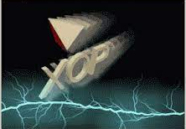
Introduction to XOPPY
Transport of power in a Beamline
Manuel Sanchez del Rio
srio@esrf.eu
Advanced Analysis & Precision Unit, MEG/ISDD, ESRF
May 29th 2023
XOPPY

Slide 3
Transport of power in a Beamline
Outline:
Basics
History
Source emission: Flux and power spectra.
Optical elements: characteristics and absorbed power.
Flux and power that arrive to the sample
XOPPY

Slide 4
Basics

Slide 5
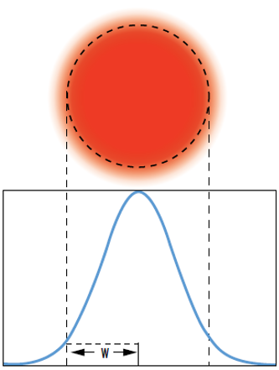
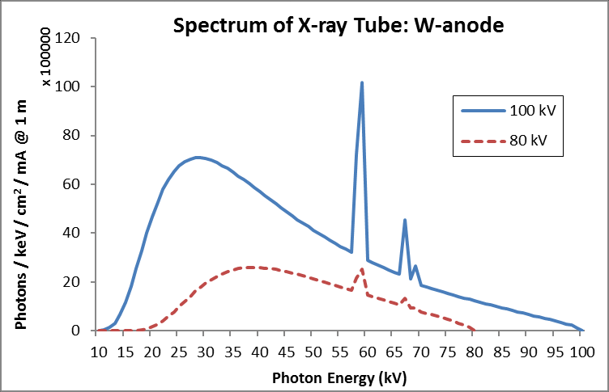
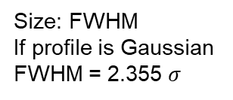
The Beam: Spectrum and Size
A light beam or beam of light is a directional projection of light energy radiating from a light source.
Collection of particles [photons]
Collection of waves
The main parameters can be represented:
As histograms if they are discrete variables
As functions if they are continuous variables
Spectrum I(E) Beam profile I(x,y) [cartesian]
y
x
I(E,x,y)
CORRELATED!
Size: FWHM
If profile is Gaussian
FWHM = 2.355 $σ$

Slide 6
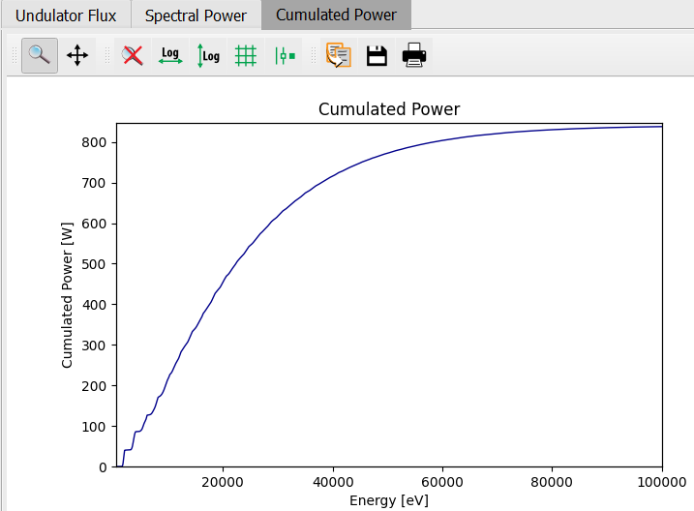
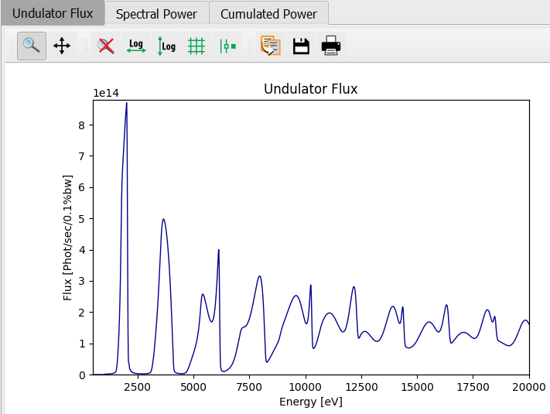
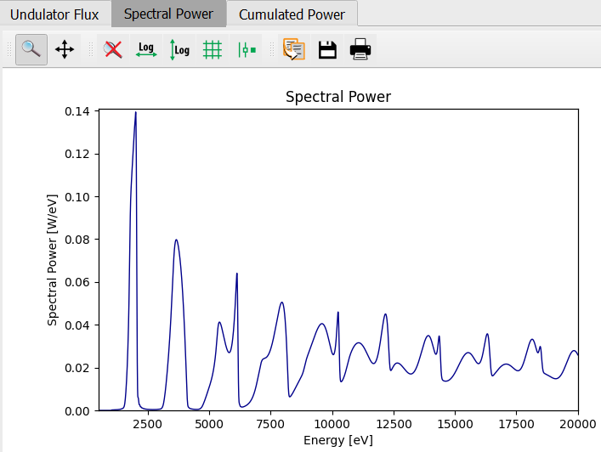
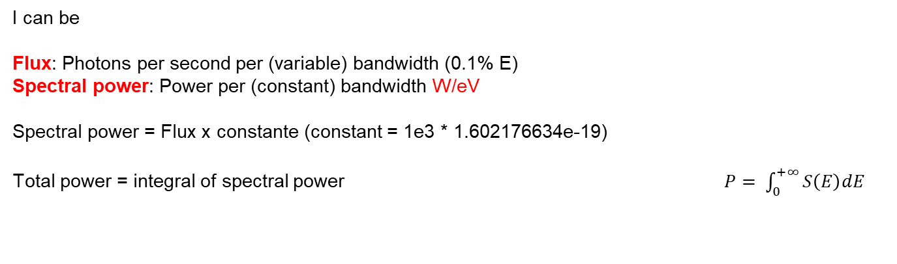
Intensity vs E
I can be
Flux: Photons per second per (variable) bandwidth (0.1% E)
Spectral power: Power per (constant) bandwidth W/eV
Spectral power = Flux x constante (constant = 1e3 * 1.602176634e-19)
Total power = integral of spectral power $P= \int_{0}^{+∞}{S\left(E\right)dE}$
cte = 1e3 * 1.6e-19

Slide 7
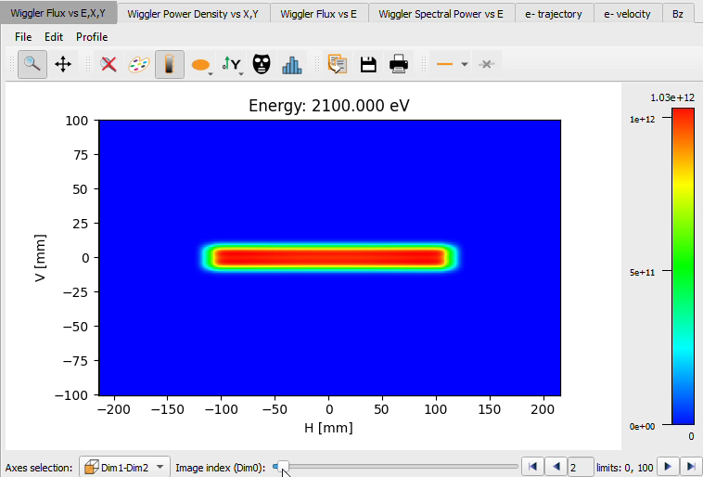
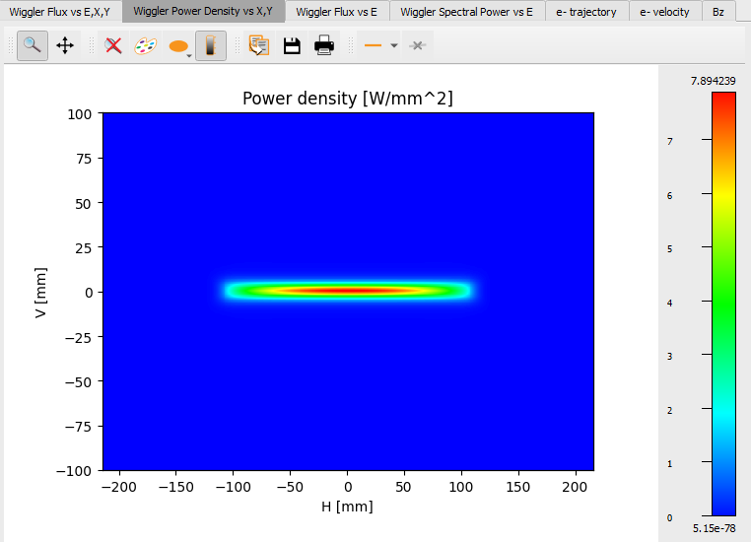
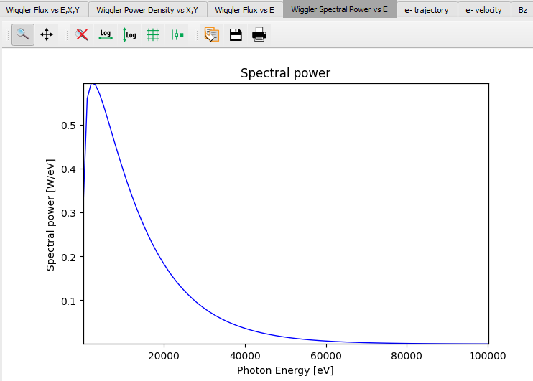
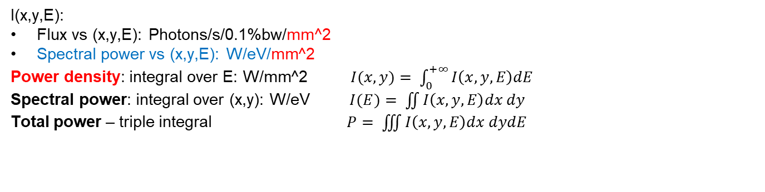
I(E) and I(x,y) are correlated (3D dependency)
I(x,y,E):
Flux vs (x,y,E): Photons/s/0.1%bw/mm^2
Spectral power vs (x,y,E): W/eV/mm^2
Power density: integral over E: W/mm^2 $I(x,y)= \int_{0}^{+∞}{I\left(x,y,E\right)dE}$
Spectral power: integral over (x,y): W/eV $I(E)= \iint{I\left(x,y,E\right)dx dy}$
Total power – triple integral $P= \iiint{I\left(x,y,E\right)dx dydE}$

Slide 8
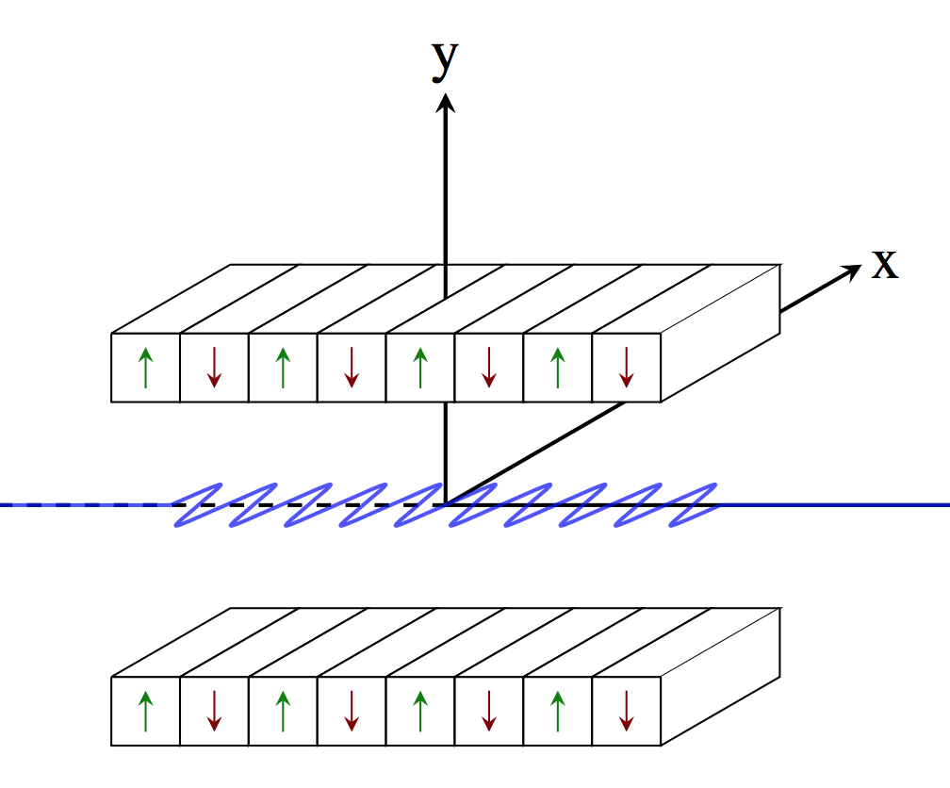
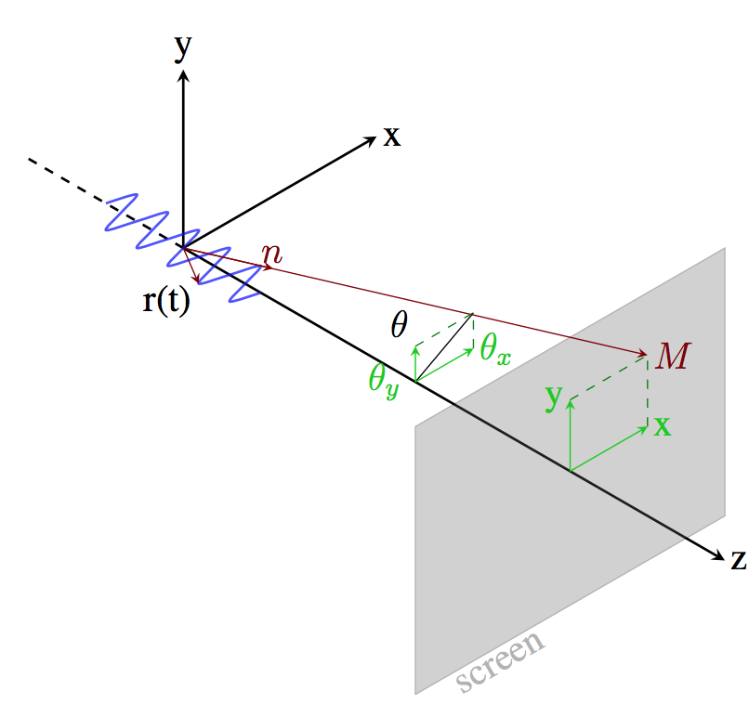
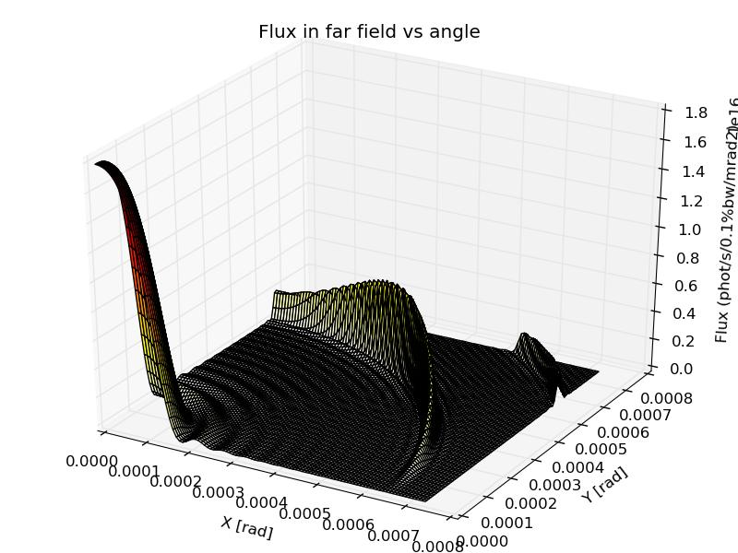
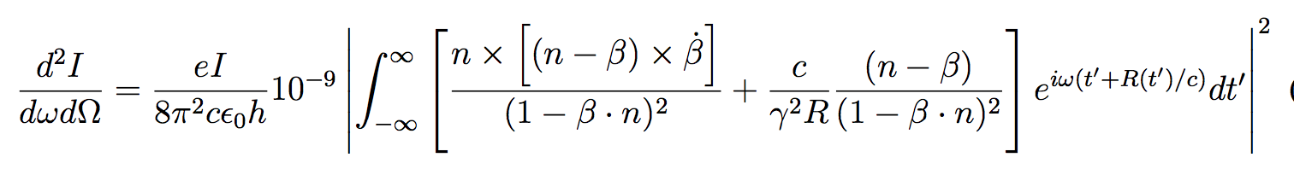
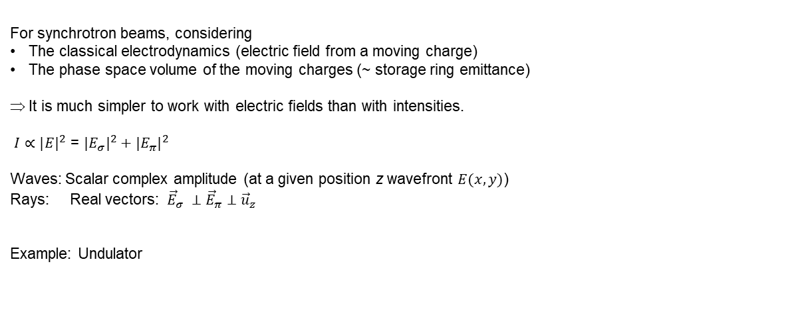
How I is calculated?
For synchrotron beams, considering
The classical electrodynamics (electric field from a moving charge)
The phase space volume of the moving charges (~ storage ring emittance)
It is much simpler to work with electric fields than with intensities.
$I∝{|E|}^{2}$ = ${|E_{σ}|}^{2}+{|E_{π}|}^{2}$
Waves: Scalar complex amplitude (at a given position z wavefront $E(x,y)$)
Rays: Real vectors: ${\vec{E}}_{σ} ⊥{\vec{E}}_{π}$ $⊥{\vec{u}}_{z}$
Example: Undulator

Slide 9
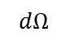
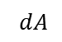
How does the beam propagates in free space?
z1
z2
?
If rays: Need direction or angle and propagates as a straight line (without changing the intensity)
If waves we need an integral propagator: Fresnel etc. (changing the intensity distribution, conserving the integrated intensity
If we know how to propagate, we can define Brightness or Brilliance:
peak intensity, on-axis, and far away
[photons/s/0.1%bw/mm^2/mrad^2]
$dA$
$dΩ$

Slide 10

How the beam propagates through components – Optical Elements
Geometrical model (change propagation) Physical model (change the intensity)
[change the ray direction or the wave phase] [change the intensity via the electric field]
IDEAL LENS IDEAL ATTENUATOR
thickness
X-ray beam
Beer-Lambert Law
$$I={I_{0} e}^{−μ t}$$
material & density
f

Slide 11
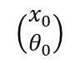
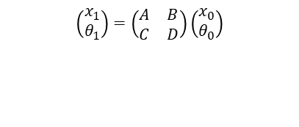
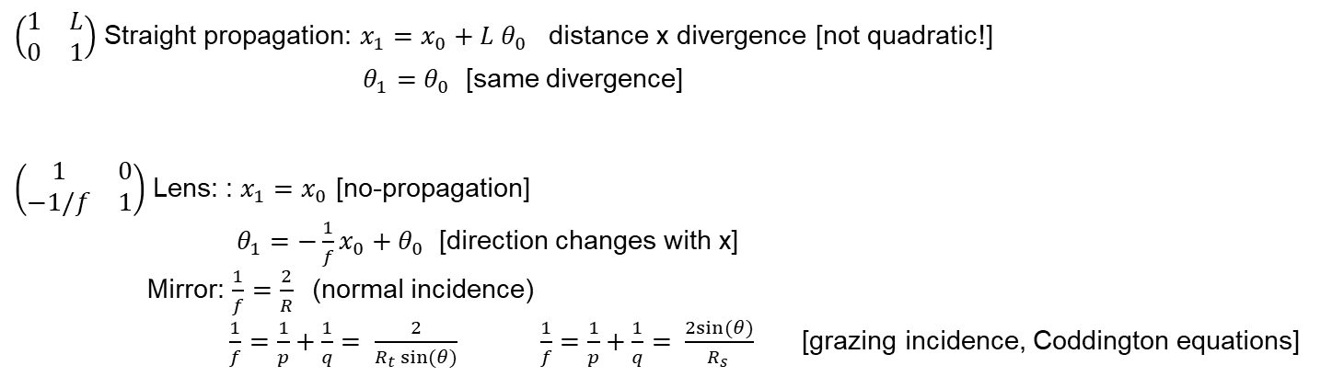
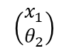
Transfer Matrix: the simplest ray-tracing
$$\left(\begin{matrix}x_{1} \\ θ_{1}\end{matrix}\right)=\left(\begin{matrix}A & B \\ C & D\end{matrix}\right)\left(\begin{matrix}x_{0} \\ θ_{0}\end{matrix}\right)$$
$$\left(\begin{matrix}x_{0} \\ θ_{0}\end{matrix}\right)$$
$$\left(\begin{matrix}x_{1} \\ θ_{2}\end{matrix}\right)$$
“linear” black box
$\left(\begin{matrix}1 & L \\ 0 & 1\end{matrix}\right)$ Straight propagation: $x_{1}=$ $x_{0}+L{ θ}_{0}$ distance x divergence [not quadratic!]
$θ_{1}=$ $θ_{0}$ [same divergence]
$\left(\begin{matrix}1 & 0 \\ −1/f & 1\end{matrix}\right)$ Lens: : $x_{1}=$ $x_{0}$ [no-propagation]
$θ_{1}={−\frac{1}{f}x_{0}+θ}_{0}$ [direction changes with x]
Mirror: $\frac{1}{f}=\frac{2}{R}$ (normal incidence) $\frac{1}{f}=\frac{1}{p}+\frac{1}{q}= \frac{2}{R_{t} sin⁡(θ)} \frac{1}{f}=\frac{1}{p}+\frac{1}{q}= \frac{2sin⁡(θ)}{R_{s} }$[grazing incidence, Coddington equations]

Slide 12
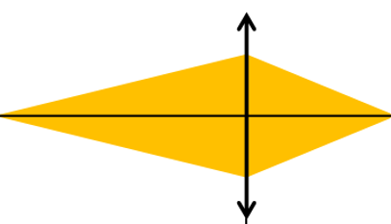
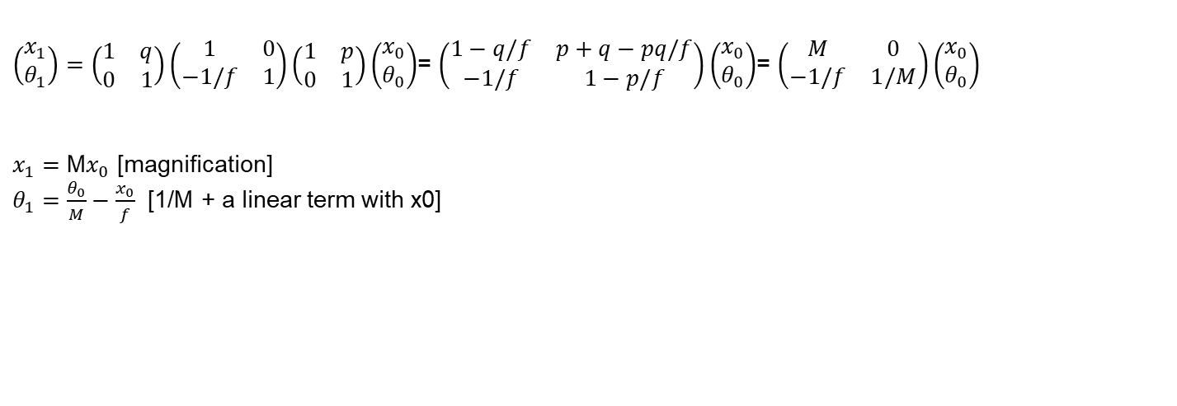
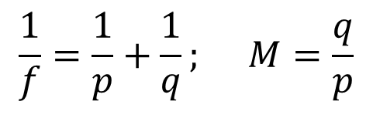
Transfer Matrix: typical p:q focusing
Lens equation Magnification
S
s = S x M
$$\frac{1}{f}=\frac{1}{p}+\frac{1}{q}; M=\frac{q}{p}$$
p
q
$\left(\begin{matrix}x_{1} \\ θ_{1}\end{matrix}\right)=\left(\begin{matrix}1 & q \\ 0 & 1\end{matrix}\right)\left(\begin{matrix}1 & 0 \\ −1/f & 1\end{matrix}\right)\left(\begin{matrix}1 & p \\ 0 & 1\end{matrix}\right)\left(\begin{matrix}x_{0} \\ θ_{0}\end{matrix}\right)$= $\left(\begin{matrix}1−q/f & p+q−pq/f \\ −1/f & 1−p/f\end{matrix}\right)\left(\begin{matrix}x_{0} \\ θ_{0}\end{matrix}\right)$= $\left(\begin{matrix}M & 0 \\ −1/f & 1/M\end{matrix}\right)\left(\begin{matrix}x_{0} \\ θ_{0}\end{matrix}\right)$
$x_{1}=$ M$x_{0}$ [magnification]
$θ_{1}=$ $\frac{θ_{0}}{M}−\frac{x_{0}}{f}$ [1/M + a linear term with x0]

Slide 13
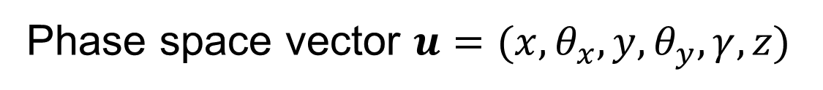
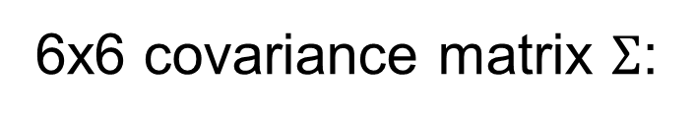
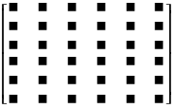
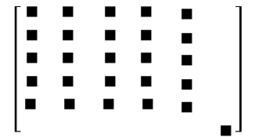
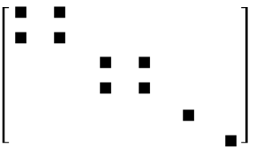
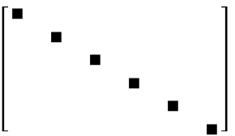
Other matrix-based systems: The electron beam dynamics
Statistically distributed bunches
P₁
P₂
P₃
General
No z-coupling
Finite alpha
Symmetry point

Slide 14
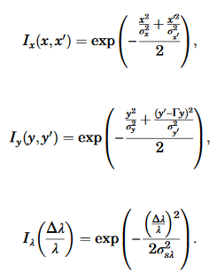
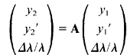
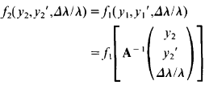
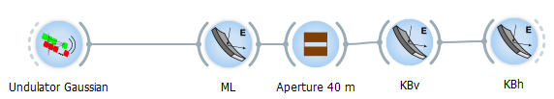
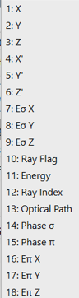
Extending Transfer Matrix: Phase Space Analysis, Ray tracing
Phase Space Analysis:
https://doi.org/10.1364/AO.47.00E116
Too basic:
Gaussian-shaped beam at the source
Gaussian elements
Linear (matrix) operators.
These limitations are not in full ray tracing [shadow]:
18D phase space
fully non-linear operators (able to calculate aberrations, surface errors, tolerances, etc.)
…

Slide 15
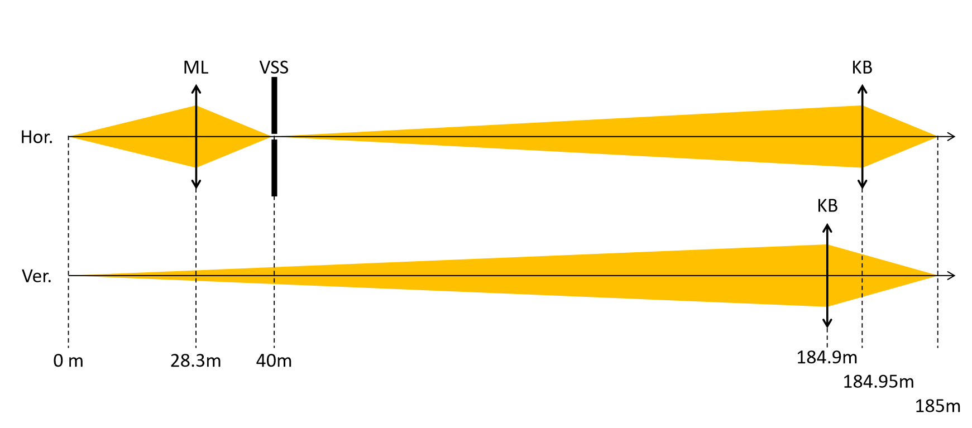
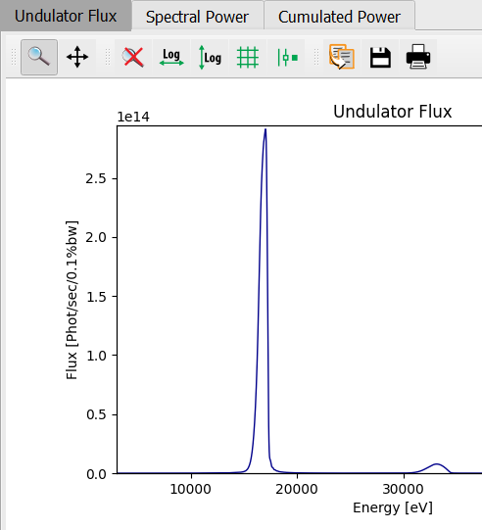
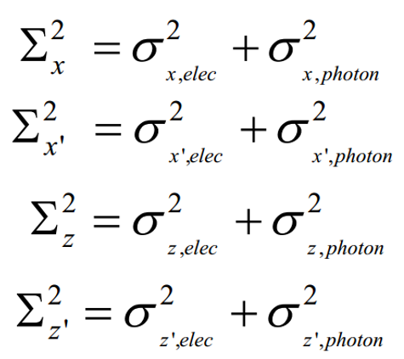
Hand-calculations. Example ESRF ID16A. Undulator source
Ref. M. Sanchez del Rio et al, JSR 26 1887 (2019)
https://doi.org/10.1107/S160057751901213X
U18.3 17keV
L=1.4m
Single e⁻
Photon source
Photon single electron emission at wavelength 0.719735 A:
sigma_r: 2.19583 um
sigma_rprime: 4.93133 urad
Electron sizes:
sigma_x: 30.1836 um
sigma_z: 3.63641 um
sigma_x': 4.36821 urad
sigma_z': 1.37498 urad
Photon source sizes (convolution):
Sigma_x: 30.2634 um
Sigma_z: 4.24796 um
Sigma_x': 6.58781 urad
Sigma_z': 5.11944 urad
Divergence:
Size:

Slide 16
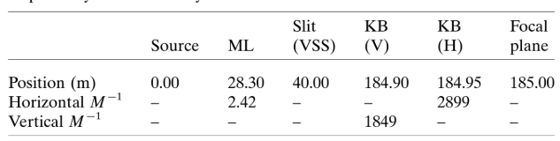
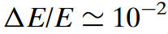
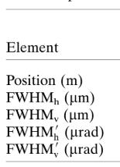
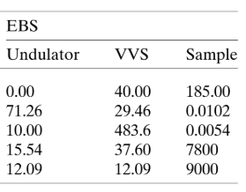
Hand-calculations. Example ESRF ID16A Beam sizes and flux
Flux: use geometrical crop
Initial (source): 2.9e14 / 17 ph/s/eV
Monochromator: x 1e-2 * 17000 = 170
Crop VSS (none for EBS)
KBV (60mm) 7.1%
KBH (26mm) 40%
Total 2.85%. Thus 8.3 10¹³
Apply mirror reflectivity

Slide 17

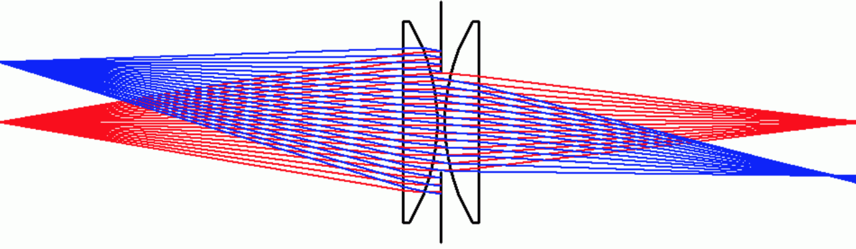
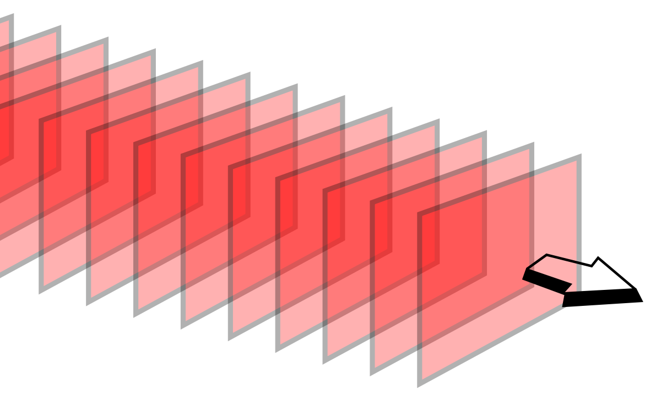
Hyerarchical simulations with Oasys
COMPLEXITY
Analytical model (by hand and XOPPY)
Ray tracing (ShadowOui)
Hybrid model (ShadowOui)
Simplified wave optics (WOFRY) Coherent Mode Decomposition (2D CMD also possible)
Monte Carlo (multi e⁻) wave optics (SRW)
Ref. M. Sanchez del Rio et al, JSR 26 1887 (2019)
https://doi.org/10.1107/S160057751901213X

Slide 18
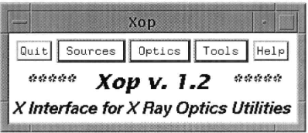
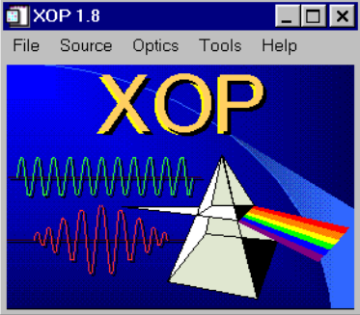
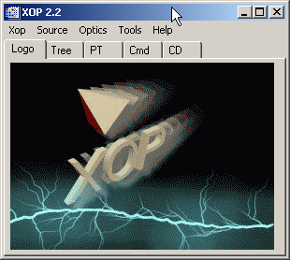
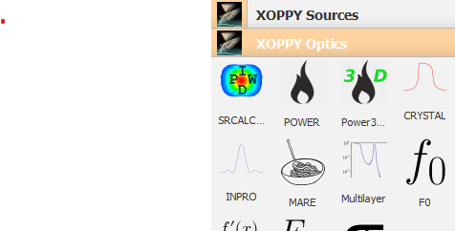
XOPPY history
1996
XOP (X-ray Oriented Programs) (http://dx.doi.org/10.1063/1.1147376)
a user interface to useful tools for the beamline designer
collaboration ESRF-APS (M. Sanchez del RIO and Roger J. Dejus)
it included some tools for synchrotron spectra (US, URGENT), and a bunch of pieces of SHADOW to compute BM and wiggler sources, crystal, multilayer and mirror reflectivities.
The interface was written in the IDL binding Fortran codes
XOP evolved (2004-2011) with mode dedicated codes and a new optical constants database (DABAX) (http://dx.doi.org/10.1117/12.893911 )
The XOP concept migrated to OASYS, and new interfaces were created in python (therefore the name of the add-on XOPPY) but always maintained the initial philosophy of “toolbox”
OASYS-XOPPY uses xraylib. Many new features have been added: 3D calculations (E,x,y) SRCalc Scripting DABAX available
2004
2009
2013-2023

Slide 19
Sources

Slide 20



Simulation of source emission
Source spectrum (Photon flux or spectral power vs Energy)
XOPPY
Undulator
Wiggler
bending magnet
Bending
magnet

Slide 21








Undulator emission simulation
XOPPY
ESRF ID20 U32c
Undulator period
$$K ≡\frac{eB_{0}λ_{u}}{2πmc}=0.9337B_{0}[T]λ_{u}[cm]$$
$$λ_{n}=\frac{λ_{u}}{2γ^{2}n}\left(1+\frac{K^{2}}{2}+γ^{2}θ^{2}\right)$$
Photon wavelength
(harmonics)
Slit
“red shift”
$$θ$$
U42
30 m

Slide 22




Undulator emission simulation: Peak position vs aperture size
XOPPY
1st harmonic
$$λ_{n}=\frac{λ_{u}}{2γ^{2}n}\left(1+\frac{K^{2}}{2}+γ^{2}θ^{2}\right)$$
~50 eV
U42
Slit
$$θ$$
30 m

Slide 23






Undulator emission simulation: Peak position vs K
XOPPY
$$K↑ ⇒ λ_{n}↑ ⇒ E_{n}↓$$
$$λ_{n}=\frac{λ_{u}}{2γ^{2}n}\left(1+\frac{K^{2}}{2}+γ^{2}θ^{2}\right)$$
Memorandum:
$E\text{[}\text{eV}\text{]}= \frac{hc}{e}\frac{1}{ λ \text{[}\text{m}\text{]}}$= 1.2398e-06 $\frac{1}{ λ \text{[}\text{m}\text{]}}$
U42
$$K$$

Slide 24





Undulator emission simulation: Peak position vs K
XOPPY
$$λ_{n}=\frac{λ_{u}}{2γ^{2}n}\left(1+\frac{K^{2}}{2}+γ^{2}θ^{2}\right)$$
U42
$$K\sim B$$

Slide 25







Undulator emission simulation (gap)
$$e^{−}$$
Gap
$$K=0.9337B_{0}[T]λ_{u}[cm]$$
$$B_{0}=a∗e^{(−bπ∗\frac{gap}{λ_{u}})}$$

Slide 26






Undulator emission simulation
$$e^{−}$$
Gap
$$λ_{u}$$
Reducing
the gap
incrementing K
larger wavelength
$$B_{0}=a∗e^{(−bπ∗\frac{gap}{λ_{u}})}$$
$$K=0.9337B_{0}[T]λ_{u}[cm]$$
$$λ_{n}=\frac{λ_{u}}{2γ^{2}n}\left(1+\frac{K^{2}}{2}+γ^{2}θ^{2}\right)$$

Slide 27


Simulation of source emission
Undulator Spectrum (Flux/Spectral power)$I(E)$
Undulator power density (power vs x, y) $I(x,y)$
Undulator radiation (flux/power vs x, y, E) $I(E, x,y)$
Wiggler Spectrum $I(E)$
Wiggler radiation $I(E, x,y)$

Slide 28






Simulation of source emission
Undulator spectral flux density
(flux/power vs x, y, E)
Wiggler [and short ID’s] spectral flux density
(flux/power vs x, y, E)
Photon Energy [eV]
1000 5000 10000 15000 20000
y
Photon flux
E
x
Power density distribution of ESRF-3PW
https://jacow.org/medsi2020/papers/wepb17.pdf

Slide 29




Undulator power density projected (Power vs x, y)
For example, this tool is very useful to get the heat load on a slit:
Water cooled high power slit
undulator

Slide 30



Undulator power density (Power vs x, y)
In most of the beamlines at the ESRF the are horizontal slits at 16 m from the source:
Perpendicular to the beam
Project over the slit surface (2º angle)
X-ray beam
Finite element analysis

Slide 31
Optical Elements

Slide 32








Material constants libraries xraylib https://github.com/tschoonj/xraylib
Other apps with other data:
XCOM: https://physics.nist.gov/PhysRefData/Xcom/html/xcom1.html
S. Stepanov server: https://x-server.gmca.aps.anl.gov/
CXRO server: https://henke.lbl.gov/optical_constants/

Slide 33


Power transport on a beamline
Optical components that could be present in a beamline:
Focusing system
Front end
Primary slits
Monochromator
Source
Sample
Primary mirrors
KB mirrors
Water-cooled
slits
Windows

Slide 34

Power transport on a beamline
Optical components that could be present in a beamline:
Focusing system
Front end
Primary slits
Monochromator
Source
Sample
Primary mirrors
KB mirrors
Water-cooled
slits
Windows
Slit 1
Aperture (a)
Source
Projected size at
downstream element (A)
Distance from the source (d)
Distance from the source (D)
$$A= \frac{D}{d}a$$

Slide 35



Filter or attenuator (window) absorption
Filters of different thickness
Filters of different materials

Slide 36



Power absorbed by a filter or attenuator
Heat load on filters @ 23 m with a projection of 2 mm x 1 mm:
U42-EBS
thickness
Material | Thickness [μm] | Absorbed Power [W]
Be | 300 | 19
Diamond | 300 | 40
X-ray beam
material & density

Slide 37




Power absorbed by a filter
Heat load on filters @ 23 m with a projection of 2 mm x 1 mm:
Be (300 μm)
Diamond (300 μm)

Slide 38
Power transport on a beamline
Optical components that could be present in a beamline:
Focusing system
Front end
Primary slits
Monochromator
Source
Sample
Primary mirrors
KB mirrors
Water-cooled
slits
Windows
Absorption by filters
Slit 1
Aperture (a)
Source
Absorption power by mirror

Slide 39



Mirror absorption
Fresnel equations give the reflectivity as a function of angle and photon energy. As a consequence, one gets the critical angle:
Si σ-reflectivity
Same material, different angles
Same angle, different coatings

Slide 40




Mirror absorption
1st Harmonic
Example of reflection, primarily mirrors @ 30 m
Absorbed power 113 W
1st Harmonic
3rd Harmonic
3rd Harmonic
Absorbed power 52 W

Slide 41


Power absorbed by a mirror
Heat load on mirrors @ 30 m:
Si (7 mrad)
Diamond (100 μm) + Rh (3 mrad)

Slide 42

Calculation of flux at the sample position
Example of getting the flux at the sample position:
KB slits
51 m
Front end
Primary slits
Focusing system
Monochromator
Source
Sample
Primary mirrors
KB mirrors
Water-cooled
slits
XOPPY: Total photons per second 1.32091E+13 at 5000 eV
*
ShadowOui: Integrated Flux : 1.25338e+13 ph/s

Slide 43





Other optical elements in XOPPY: Multilayers
[W(25)/Si(25)]₅₀
1.4º
$${mλ =2d}_{M}sinθ\sqrt{1−\frac{2\overline{δ}}{\sin^{2}θ}}$$

Slide 44




Other optical elements in XOPPY: Crystals
Crystals
Intensity
2θ
Laue's kinematic theory:
small crystals (e.g. powder diffraction).
Dynamical theory of diffraction:
Large perfect crystals (e.g. Si).
Laue's kinematic theory:
small crystals (e.g. powder diffraction).

Slide 45





FORMULATIONS OF DYNAMICAL THEORY
Darwin (1914)The Theory of X-ray Reflexion Philosophical Magazine 27, 315
Ewald (1917) Zur Begründung der Kristalloptik, Teil III Die Kristalloptik der Röntgenstrahlen Ann. Phys. 54, 519
von Laue (1915) Die Theorie der Röntgenstrahlinterferenzen in neuer Form Encyclopaedie d. math Wiss 5,3, (1931) Ergebn. Exakt. Naturwiss.10133.
Zachariasen (1945) Theory of X-ray diffraction in crystals
James (1950) The optical principles of diffraction by X-rays
Taupin (1961) Théorie dynamique de la diffraction des rayons X par des cristaux déformés Bull Soc Fr. Mineral. 84 51
Takagi (1962) Dynamical theory of diffraction applicable to crystals with any kind of small distortion Acta Crystal 15 1311
Books:
Pinsker Dynamical Scattering of X rays in Crystals (1978).
Authier Dynamical Theory of X-Ray Diffraction (2001)
Shvyd’ko X-Ray Optics—High-Energy-Resolution Applications (2004)
Si111
10 keV
Diffraction profile
or
Intrinsic profile
$$\frac{∆E}{E}\sim {10}^{−4}$$

Slide 46








Rocking curve
The rocking curve is the CONVOLUTION of the two diffraction profiles.
=
FWHM_{R} = 1 FWHM₁
=
FWHM_{R} = 1.4 FWHM₁
=
FWHM_{R} ~ 1.5 FWHM₁
_{Si111 8 keV}
For a full discussion about rocking curves see: Masiello et al. J. Appl. Crystall. 47, 1304-1314 (2014)

Slide 47


Crystal phase retarders
R
R
BRAGG
T
LAUE
T
Perfect crystals are birefringent elements: R_{σ} ≠ R_{π}
They introduce a phase change Φ that alter the polarization of the beam

Slide 48

Change of phase
Hirano et al., NIM A336 (1993) 343
4XGe220
50μm Si220
BRAGG
(REFLECTION)
LAUE
(TRANSMISSION)
22 μm C* 220
22 μm C* 220

Slide 49



Circular polarization
Bouchenoire, Morris, Hase
Pc = r_{s} r_{p} sin (φ_{p} - φ_{s})
XOP
Si111 5μm
C*111 128μm
E=3.174 keV

